Slide 1
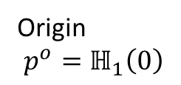



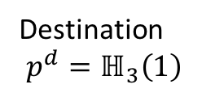


Low cost region
$$ℍ_{1}\left(1\right)=ℍ_{2}\left(0\right)$$
$$ℍ_{2}$$
$$ℍ_{1}\left(s\right)$$
$$ℙ$$
$$ℍ_{3}$$
High cost region
Origin
$$p^{o}=ℍ_{1}\left(0\right)$$
Destination
$$p^{d}=ℍ_{3}\left(1\right)$$

